Slide 1

CYBERTHON.AI - 2025
CHANDIGARH POLICE (IN PARTNERSHIP WITH INFOSYS, CHANDIGARH)

Slide 2
TOPICS AVAILABLE
Problem Statements: https://sites.google.com/view/cyberthonai2025/home
Cybercrime: Real-Time AI-Based Phishing Email Detection System: Design a system that uses AI to analyze email headers, textual patterns, metadata, and attachments to detect and quarantine phishing emails in real time. Deliverables: Trained phishing detection model, API for email integration, dashboard for alerts and logs. Intelligent Financial Fraud Detection using UPI and VoIP Data: Develop a smart system that uses machine learning to detect and alert about fraudulent UPI transactions, scam VoIP calls (including spoofed numbers), and suspicious payment patterns. Deliverables: Dataset simulation, fraud scoring engine, alert system prototype for real-time monitoring. AI-Based Social Media Monitoring Tool for Crime Trends: Create an AI solution that scans public social media content to detect hate speech, cyberbullying, fake accounts, incitement to violence, and threats to public safety. Deliverables: Dashboard with analytics, real-time alert system, NLP-based threat categorization engine. Ransomware Incident Simulation & Training Platform: Develop an interactive simulator for law enforcement officers to understand ransomware attack scenarios and build strategic response mechanisms. Deliverables: Web-based simulation interface, ransomware propagation logic, and scenario-building toolkit. Deepfake & AI-Generated Media Detection Tool: Design a forensic tool to identify manipulated images, videos, or voice recordings used for impersonation or blackmail. Deliverables: Deep learning model, test suite of fake vs. original content, browser-based interface for testing.

Slide 3
TOPICS AVAILABLE
Problem Statements: https://sites.google.com/view/cyberthonai2025/home
Smart Policing Facial Recognition System for Identifying Missing Persons: Build a tool that compares CCTV footage, social media photos, and public databases to help trace missing individuals using facial recognition. Deliverables: Face detection model, matching engine, interface for uploading and viewing results. Voice Emotion Recognition from Emergency Calls: Develop an AI system that can analyze voice inputs from helpline/emergency calls to detect distress, aggression, or urgency using tone analysis and NLP. Deliverables: Real-time audio analyzer, pre-trained emotion classification model, dashboard for call responders. Voice & Chatbot Assistant for Police Personnel: Create a mobile-friendly, multilingual chatbot that provides instant access to legal sections (IPC, CrPC), departmental forms, and SOPs. Deliverables: Chatbot application, IPC/CrPC searchable database, voice-to-text integration. Automated Traffic Violation Detection System Using AI: Design a smart traffic monitoring system that detects and records violations like speeding, signal jumping, and helmet-less driving using live CCTV feeds. Deliverables: Video feed parser, violation classification model, violation reporting module. Suspicious Behavior Detection System for Public Surveillance: Develop a computer vision system that flags abnormal/suspicious movements in real-time (e.g., loitering, unattended baggage, sudden dispersals). Deliverables: Pre-trained object detection model, alert module, real-time video annotation system.

Slide 4
TOPICS AVAILABLE
Problem Statements: https://sites.google.com/view/cyberthonai2025/home
Dark Web & Financial Crimes Dark Web Activity Monitoring and Alert System: Design a system to crawl dark web marketplaces and forums to extract and analyze discussions or listings involving drugs, arms, stolen data, or fake IDs relevant to India. Deliverables: Custom crawler, keyword alert engine, categorized threat intelligence dashboard. Cryptocurrency Transaction Tracker for Illicit Activities: Build a visual analytics tool to trace cryptocurrency wallets, transactions, and movement across exchanges to flag suspicious activity related to ransomware or dark web trade. Deliverables: Wallet tracing engine, blockchain visualizer, wallet-risk scoring algorithm. AI-Driven Dark Web Crawler and Alert Generator: Create an AI-enabled tool to index and monitor onion sites, marketplaces, and forums for leaked Indian data or criminal content. Deliverables: Crawler with NLP filtering, alert system with categorization, visual search interface. AI in Forensics & Investigation Audio/Video Enhancement System for Forensic Evidence: Develop a tool that enhances low-quality audio/video inputs for clarity in forensic investigations (e.g., noisy calls, grainy CCTV). Deliverables: AI model for de-noising/enhancement, comparison module, forensic-ready export formats. Crime Scene Image Analysis & Reconstruction Assistant: Design an AI tool that uses uploaded crime scene images to reconstruct the sequence of events or generate potential 3D layouts. Deliverables: Image parser, event modeling engine, 2D/3D layout generator with annotation features.

Slide 5
TOPICS AVAILABLE
Problem Statements: https://sites.google.com/view/cyberthonai2025/home
Additional Proposed Problem Statements (Relevant & Feasible) VoIP Scam Call Pattern Detection & Blacklist Engine: Create a tool that analyzes patterns in incoming scam calls (e.g., lottery frauds, KYC update frauds) and blocks recurring VoIP abuse. Deliverables: VoIP dataset simulation, scam classifier engine, integration with call-blocking app. UPI Scam Detection and Victim Alert System: Develop an ML-based system that learns from UPI fraud complaint databases and flags suspicious transaction behavior in real-time to help warn victims. Deliverables: Transaction analysis model, fraud alert generator, reporting interface for victims. SIM-Swap Fraud Early Detection Assistant: Design a system that can detect early signs of SIM-swap fraud by correlating sudden changes in network behavior, UPI deregistrations, and OTP bypass logs. Deliverables: Telco + bank signal simulator, fraud correlation engine, alert dashboard.

Slide 6
Submission Guidelines:
1. At least 50% code of overall Solution should be completed by teams before submission (due date is 31st May 2025 by 2359 hrs IST)
2. Teams can continue working on the solution post submission – till final presentation is not done during in-person event.
3. At In-person event, Top qualified Teams (after submission round) can refine their solutions along with Master Hacks Team before final presentation which is planned for 2 days ~ 13th and 14th June 2025 @Chandigarh

Slide 7
Guidelines
The participants are allowed to work only on given problem statements and develop the solution related to one of these problem statements.
The solution must be designed and developed after the nomination is submitted. Already developed (existing) solutions will be rejected.
A Team can have max 4 members including a Team Lead.
Each Team has to nominate and submit their solution design & details as per given timelines.
The participants under Student category, must be pursuing an active academic year and not doing part time or full time job.
Jury will check all the submissions and select top ideas or solutions to participate in ‘In-Person’ round at campus. The experts will guide and mentor the selected teams to enhance their solution to present in front of Jury on closing day.
Winning solutions will have an opportunity for further development of the solution with hand holding from Infosys, Chandigarh and Chd Police so that it can be implemented in future.
Teams selected for in-person round, the participants have to make their own arrangements for travel. Organizing team will arrange the meals, refreshments and overnight stay.
Jury Decision will be final.

Slide 8

CONTENTS
Team Details
Problem Statement – Description / theme selected
Solution Proposed
Expected Benefits to Policing
Technical Design / Architectural Diagram
Solution - Screenshots
Assumptions

Slide 9
TEAM DETAILS
Team Name: Bloody Hackers
Team Members with Email-Ids:
Mayank Sajnani => mayanksajnani.bt22ece@pec.edu.in
Hardik Ahuja => hardikahuja.bt22cse@pec.edu.in
Ujjawal Sidana => ujjawalsidana.bt22ece@pec.edu.in
Kartik Sharma => kartiksharma.bt22cse@pec.edu.in
Team Leader: Mayank Sajnani
Topic Selected for Solution: <Voice Emotion Recognition from Emergency Calls>
Category : Student - Punjab Engineering College , Chandigarh

Slide 10
PROBLEM STATEMENT
Explain the main problem statement and what are critical challenges to be fixed
Voice Emotion Recognition from Emergency Calls
Our mission is to develop a real-time AI-driven audio analysis system that can detect emotional cues such as distress, aggression, or urgency from emergency and helpline calls using tone analysis and natural language processing (NLP).
This system will empower call responders to prioritize critical calls, enhance decision-making, and improve emergency response outcomes by providing actionable emotion insights.
Critical Challenges:
Hidden Emotional Cues: Human call responders may miss subtle vocal signs of distress, fear, or urgency, especially under high call volumes.
Real-Time Processing: Ensuring the system can analyze audio and provide emotion insights with minimal delay during live calls.
Multilingual & Accent Variability: Handling different languages, dialects, and accents while maintaining high accuracy in emotion detection.
Integration with Dispatch Systems: Seamless connection between emotion analysis outputs and existing dashboards and response workflows.
Privacy & Ethical Concerns: Safeguarding sensitive caller data, ensuring ethical use of AI, and maintaining public trust.

Slide 11
SOLUTION PROPOSED
Explain the solution components, data flow and main integration points
Our solution for “Voice Emotion Recognition from Emergency Calls” is a real-time AI system designed to analyze audio from emergency helpline calls, combining tone detection and natural language processing (NLP) to assess emotional states like distress, aggression, or urgency. This enables call responders to prioritize cases more effectively and improve emergency outcomes. It consists of the following key components and data flow:
Components:
Real-Time Audio Analyzer: Captures live audio streams from incoming emergency calls and preprocesses them for analysis.
Emotion Classification Model: Uses pre-trained machine learning models to detect emotional states such as fear, stress, anger, or panic from voice patterns.
Natural Language Processing (NLP) Module: Analyzes the spoken words and context to enhance emotional detection and urgency classification.
Responder Dashboard: Provides a user-friendly interface that displays live emotion signals, urgency ratings, and caller details to assist responders.
Location Classification System: Identifies and maps the caller’s location to help guide rapid response and resource allocation.

Slide 12
Data Flow:
Integration Points:
This solution empowers emergency services to shift towards emotion-aware, faster, and smarter responses, improving outcomes and saving lives.
Audio Collection: Live audio streams are captured from ongoing emergency and helpline calls.
Audio Preprocessing: The system cleans and normalizes audio inputs to remove noise and enhance clarity.
Emotion & NLP Analysis: Machine learning models analyze voice tone and spoken words to detect emotional states and assess urgency.
Dashboard Visualization: Outputs (emotional signals, urgency level, caller details) are displayed on a live dashboard for responders.
Location Mapping: Caller’s location is classified and mapped to assist with rapid response and resource allocation.
Integration with emergency call systems for seamless audio input capture.
Connection to emotion classification APIs for live emotion detection and updates.
Integration with NLP engines to analyze language content alongside voice tone.
Link to responder dashboards for real-time display of critical insights.
Integration with geolocation services for precise caller mapping and dispatch planning.

Slide 13

EXPECTED BENEFITS TO POLICING
What are the main benefits and how this solution can be adopted further?
Expected Benefits to Policing:
Our AI system for voice emotion recognition offers key improvements to emergency response:
Main Benefits:
Faster Emergency Prioritization: Quickly flags critical distress or urgency cases for immediate attention.
Resource Optimization: Helps allocate police and medical responders more efficiently.
Improved Caller Outcomes: Ensures urgent cases receive faster help, improving public safety.
Reduced Human Error: Supports responders with AI insights, reducing missed emotional cues.
Scalable & Adaptable: Can expand across helplines and integrate with multilingual and regional setups.

Slide 14
.
Adoption and Further Implementation:
Our solution is designed to be highly adaptable and scalable, allowing for ongoing improvements and expansions:
Expansion to More Helplines: Roll out across regional and national emergency services, covering more callers.
Integration with Smart Systems: Connect with IoT devices and smart city networks to enhance data and response coordination.
Collaboration with Agencies: Work alongside medical, fire, and social services for better-integrated emergency responses.
Advanced Model Refinement: Continuously improve emotion detection accuracy through advanced analytics and model updates.
Public Awareness & Training: Educate responders and the public on how emotion-aware systems improve emergency outcomes, building trust and support.
The adoption of our solution offers not only immediate benefits but also opens the door to continuous improvement and innovation in law enforcement practices. It empowers law enforcement agencies to keep communities safe and improve their overall effectiveness in crime prevention and control.

Slide 15











TECHNICAL DESIGN / ARCHITECTURAL DIAGRAM
Share HL architecture design, OR technical flow diagram to clearly show the components/services view
LOCATION TRACKING
EMOTION CLASSIFICATION
RECEIVER
OFFENDER TRACKING IN DATABASE
CALLER
REALTIME AUDIO ANALYSIS
DASHBOARD
SIGNUP FOR CALLER ANALYSIS (FOR DEPARTMRNT/GOVT USE)
REPORT SUSPICIOUS CALLS
CALL SUMMARY EXTRACTION USING NLP
TONE ANALYSIS
WORKFLOW

Slide 16
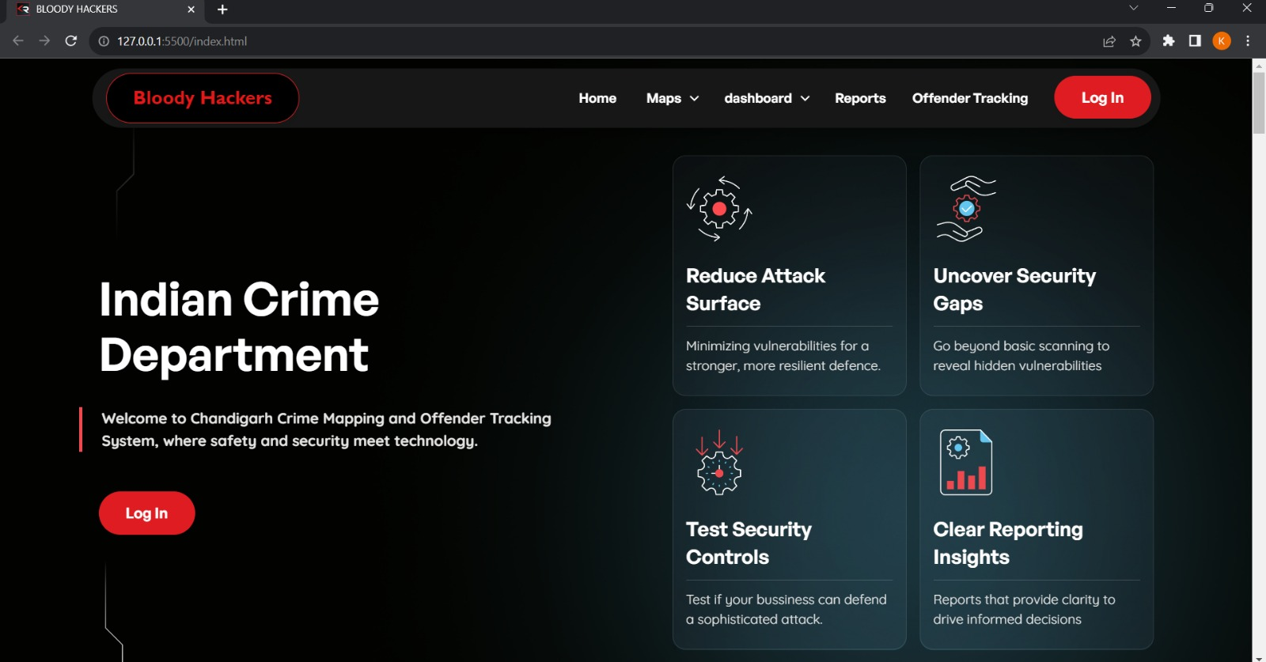
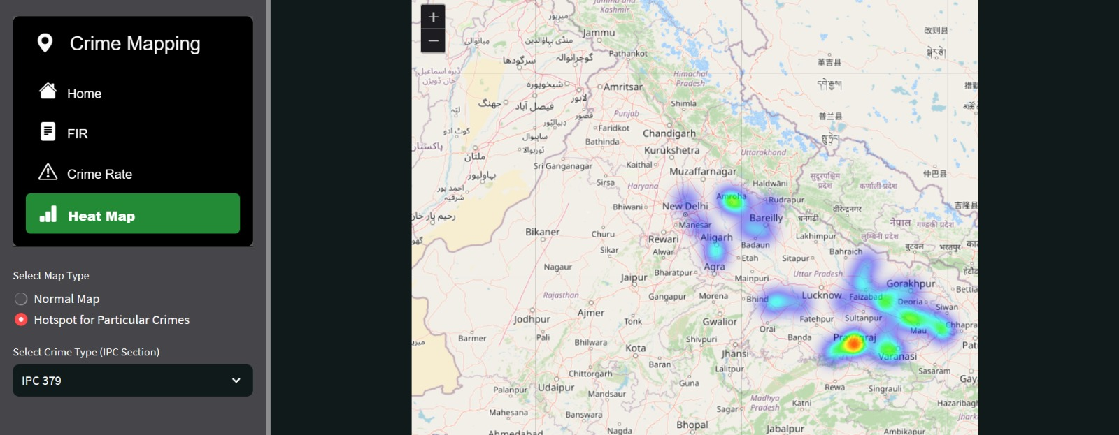
SOLUTION - SCREENSHOTS
Share the screenshots of current solution being worked upon
LIVE TRACKING
AFTER MATH ANALYSIS OF CALL

Slide 17
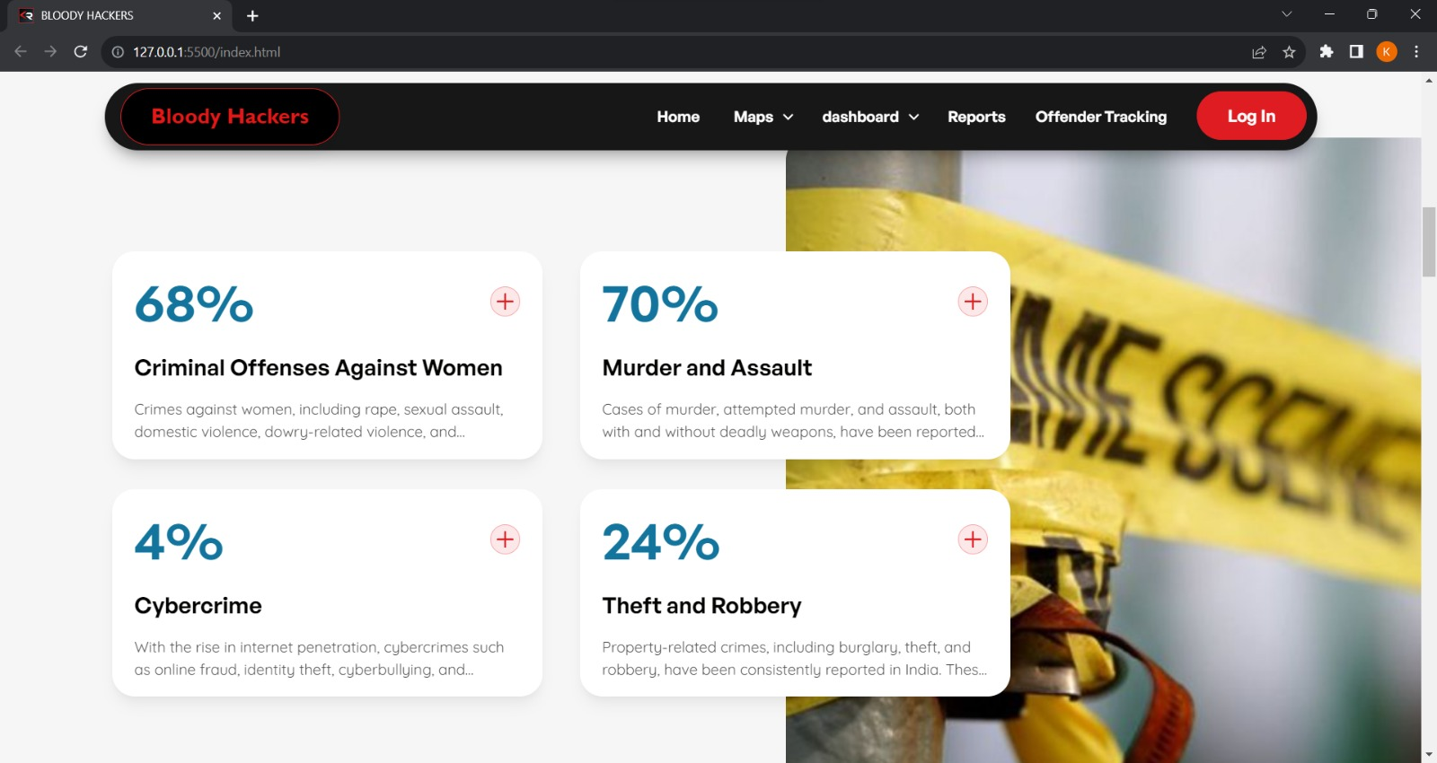
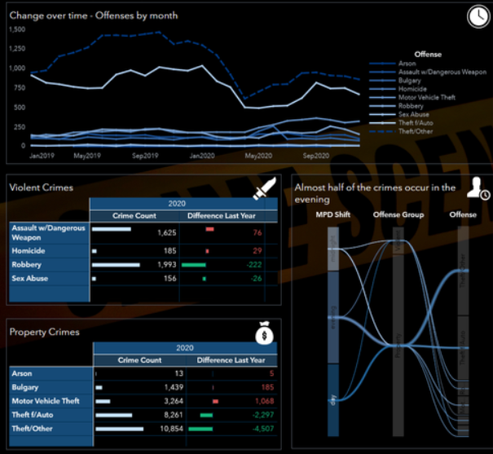
Web/App for detailed classification
Dashboard

Slide 18
ASSUMPTIONS
Explain the constraints, assumption taken up for this solution
Assumptions:
Data Availability: We assume that relevant data sources will be accessible and can be integrated into the system in a timely manner.
Data Quality: Assumption is made that the data collected from various sources will be of sufficient quality and reliability for accurate predictions.
Public Acceptance: We assume that the public will accept the use this technology and that privacy concerns can be addressed.
Funding and Resources: Assumed availability of adequate funding and resources for system development, deployment, and maintenance.
Collaboration: Assumption of collaboration between law enforcement agencies, government departments, and external organizations to facilitate data sharing and coordination.

Slide 19
Constraints:
Privacy Concerns: The use of this technology raises legitimate privacy concerns that need to be addressed.
Data Security: Ensuring data security and protection against cyber threats is a paramount concern to safeguard system integrity.
Bias and Fairness: Mitigating algorithmic bias and ensuring fairness in recognition models is a continuous challenge.
Resource Limitations: Budget and personnel limitations may affect the extent to which the solution can be deployed.
Regulatory Compliance: Compliance with relevant laws and regulations, including data protection laws, is a critical constraint.
Community Engagement: Public perception and acceptance of the solution are constraints that need ongoing efforts for building trust and cooperation.
Technological Advancements: The pace of technological advancements may affect the accuracy and capabilities of the system, necessitating continuous adaptation.
Our solution operates within these assumptions and constraints, and addressing them is integral to its successful implementation while respecting the rights and concerns of the community it aims to protect.

Slide 20

THANK YOU
TEAM - Bloody Hackers
Mail -
mayanksajnani.bt22ece@pec.edu.in

Slide 21
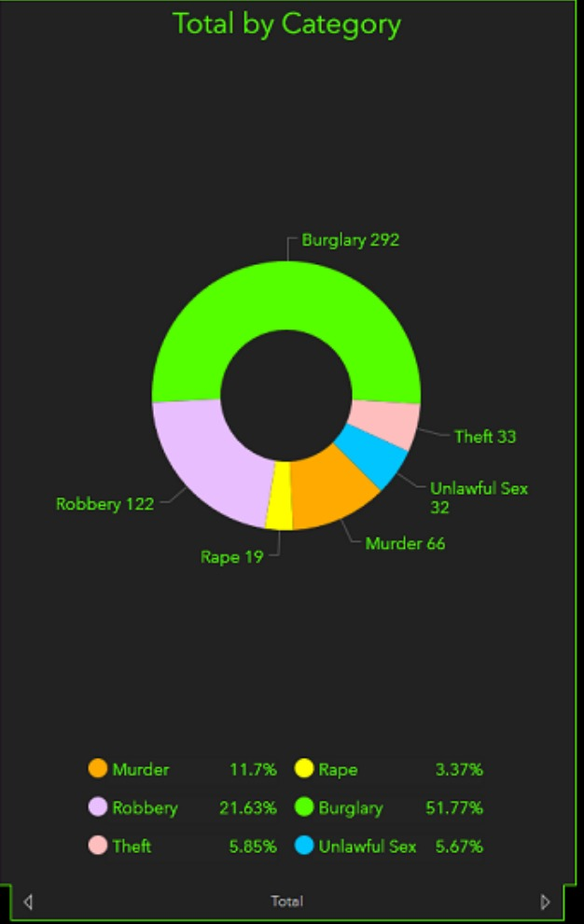
APPENDIX
Analysis
Data sources used for crime data, as well as data dictionaries for understanding the meaning and structure of the collected data.-
*Data Sources* - Law enforcement agencies - Public records - Social media data - Surveillance cameras - Emergency call logs-
*Data Dictionary* - Description of data fields - Data source details

Slide 22



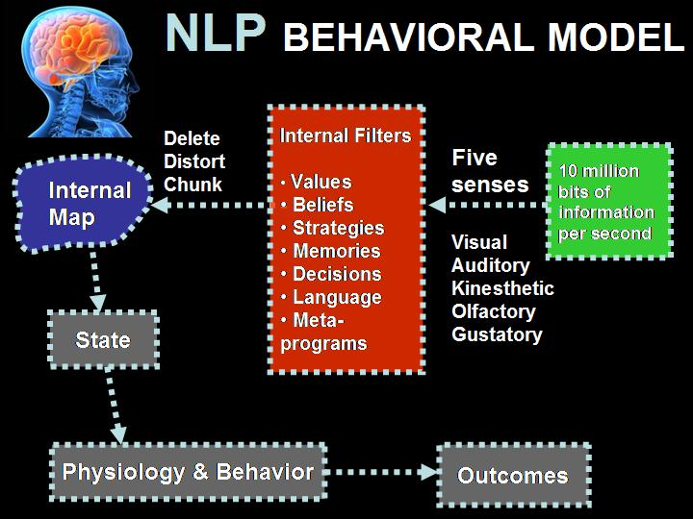









TECH REQUIREMENTS – Given above , and more are used for different processes.
Leaflet
MongoDB

